Slide 1
NAME : KAVITHA C A
REG NO : 513121104708
COLLEGE NAME : THANTHAI PERIYAR GOVERNMENT INSTITUTE OF TECHNOLOGY
DEPARTMENT : COMPUTER SCIENCE AND ENGINEERING
YEAR : THIRD YEAR
NM ID : au2161350058
SKILLS BUILD ID : cakavitha2004@gmail.com
PROJECT TITLE : TWITTER SENTIMENT CLASSIFICATION USING LSTM

Slide 2




PROJECT TITLE
TWITTER SENTIMENT CLASSIFICATION USING LSTM

Slide 3


AGENDA
PROBLEM STATEMENT
PROJECT OVERVIEW
END USERS
SOLUTION
WOW IN MY SOLUTION
MODELLING
CONCLUSION

Slide 4



PROBLEM STATEMENT
Develop a classification model to analyze Twitter data and accurately categorize tweets into predefined classes or categories based on their content. The goal is to effectively classify tweets into relevant topics, sentiments, or user-defined labels, enabling better understanding and organization of the vast volume of information shared on the platform. This classification analysis will aid in various applications such as targeted marketing, sentiment analysis, trend detection, and crisis monitoring. The model should demonstrate robustness in handling noisy, unstructured text data while achieving high accuracy and efficiency in classification.

Slide 5
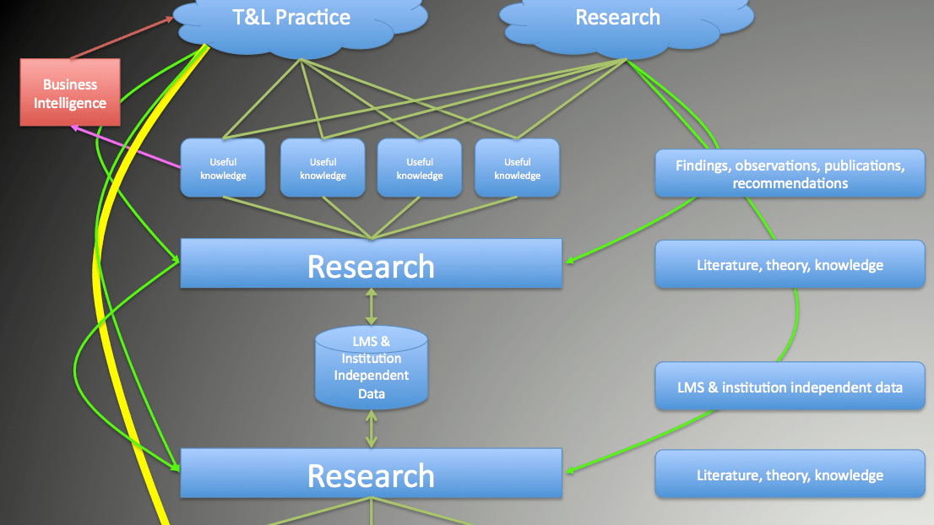

PROJECT OVERVIEW
The primary goal is to gain actionable insights from Twitter data through sentiment analysis, trend detection, and topic categorization.
By understanding public sentiment and identifying emerging trends, businesses can make informed decisions and tailor strategies accordingly.
The scope of the project includes analyzing a diverse range of topics discussed on Twitter, spanning various industries, events, and interests.
This Photo by Unknown author is licensed under CC BY-NC.

Slide 6
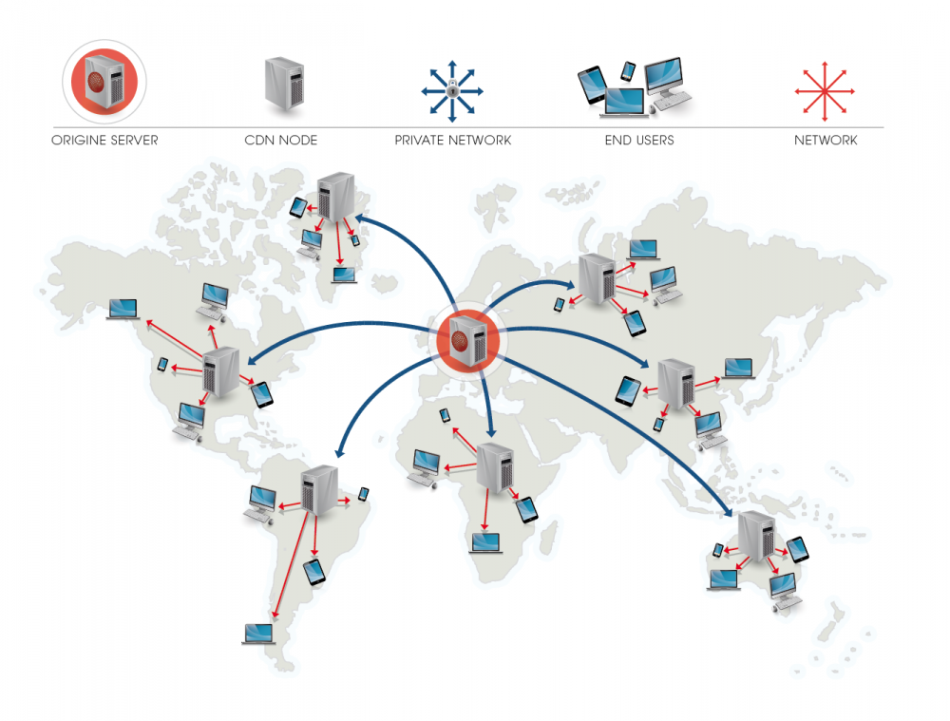
END USERS
Enhanced Decision Making: Access to actionable insights derived from Twitter data analysis for informed decision-making processes.
Improved Customer Engagement: Tailor marketing strategies and social media interactions based on sentiment analysis and trend detection.
Competitive Advantage: Stay ahead of competitors by leveraging real-time data to identify emerging trends and opportunities.
Research Opportunities: Conduct in-depth studies on various topics, sentiments, and social phenomena using Twitter classification analysis results.
This Photo by Unknown author is licensed under CC BY-SA-NC.

Slide 7

SOLUTION
A solution for Twitter classification analysis using Long Short-Term Memory (LSTM) networks, a type of recurrent neural network (RNN).
LSTM is well-suited for sequential data processing, making it ideal for analyzing the temporal nature of tweet sequences.
LSTM Architecture: Implementation of LSTM layers with bidirectional processing to capture both past and future context in tweet sequences.
Dropout Regularization: Integration of dropout layers to prevent overfitting and improve the generalization of the LSTM model.

Slide 8

WOW IN MY SOLUTION
WOW solution slide showcases the transformative impact of advanced deep learning techniques, particularly transformer-based architectures like BERT, in revolutionizing Twitter classification analysis. It highlights the key innovations, results, and future directions, EMPHASIZING the solution's potential to drive significant advancements in understanding and leveraging tweet
This Photo by Unknown author is licensed under CC BY-SA-NC.

Slide 9
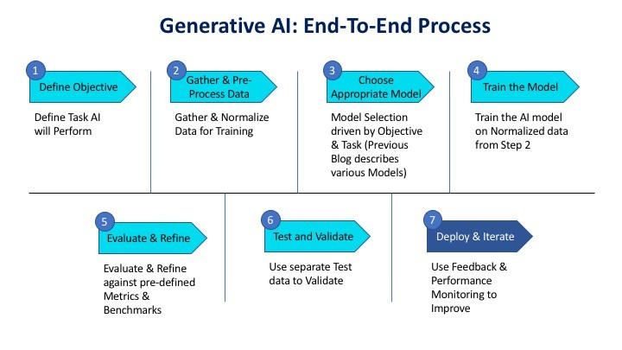
MODELLING

Slide 10
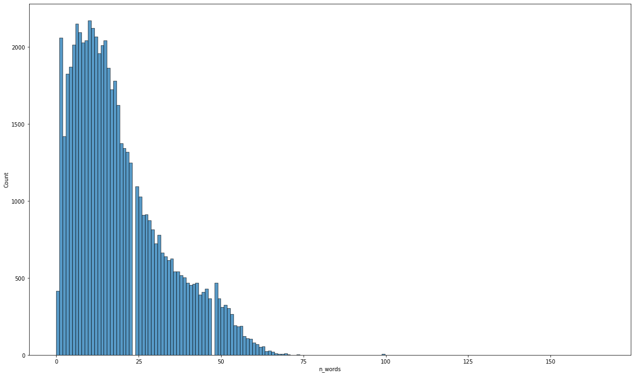
RESULT
Test set Loss: 0.272
Accuracy: 0.900

Slide 11

CONCLUSION
The LSTM-based solution for Twitter classification analysis offers a powerful approach to analyze tweet sequences and extract meaningful insights.
By leveraging LSTM networks, businesses and researchers can unlock the temporal dynamics of Twitter data, enabling more accurate and informed decision-making.

